Slide 1
ANGULAR PROJECT
BOOKSTORE
-by Rithick.R

Slide 2
Problem Statement
Userflow
users can login and check the books that have been listed in home page .
users can see the details of the book and can add the books to the cart along with the quantity and can remove if don't needed .
if the cart is empty it will be redirected to home page by clicking continue shopping..

Slide 3
Problem Statement
Adminflow - can add a new book with name of the book using submit form
Angular material is used
Internationalization is done by adding json with language French.
Typefilter is done using pipes
Login ..logout function is done using lazy loading concept

Slide 4
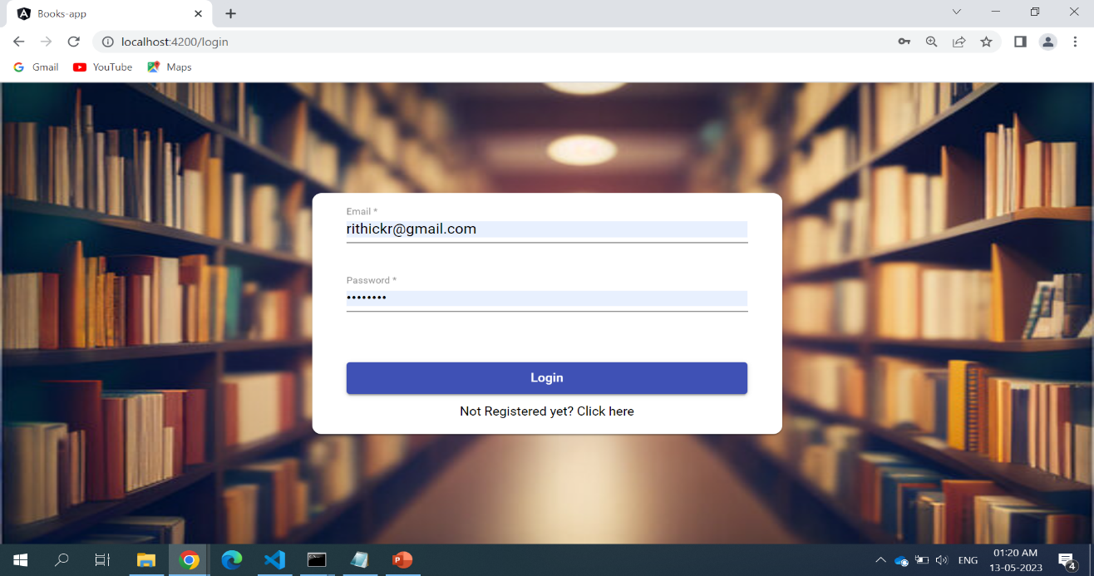
Login page
Initially a login page is created for both user and admin
It is done by using json-server-auth

Slide 5
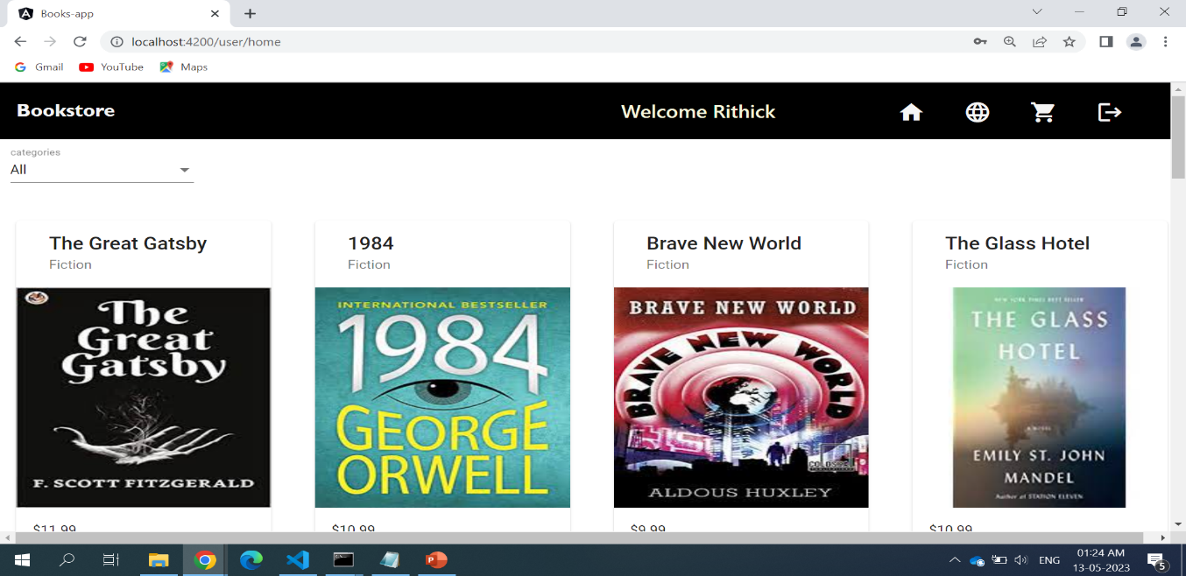
Home page
After logged in as user , this is how the products will be listed in the home page
Type filter is done for three categories of books(fiction,non-fiction,fantasy)
Products will be displayed with the respective Name, Type, and price.

Slide 6
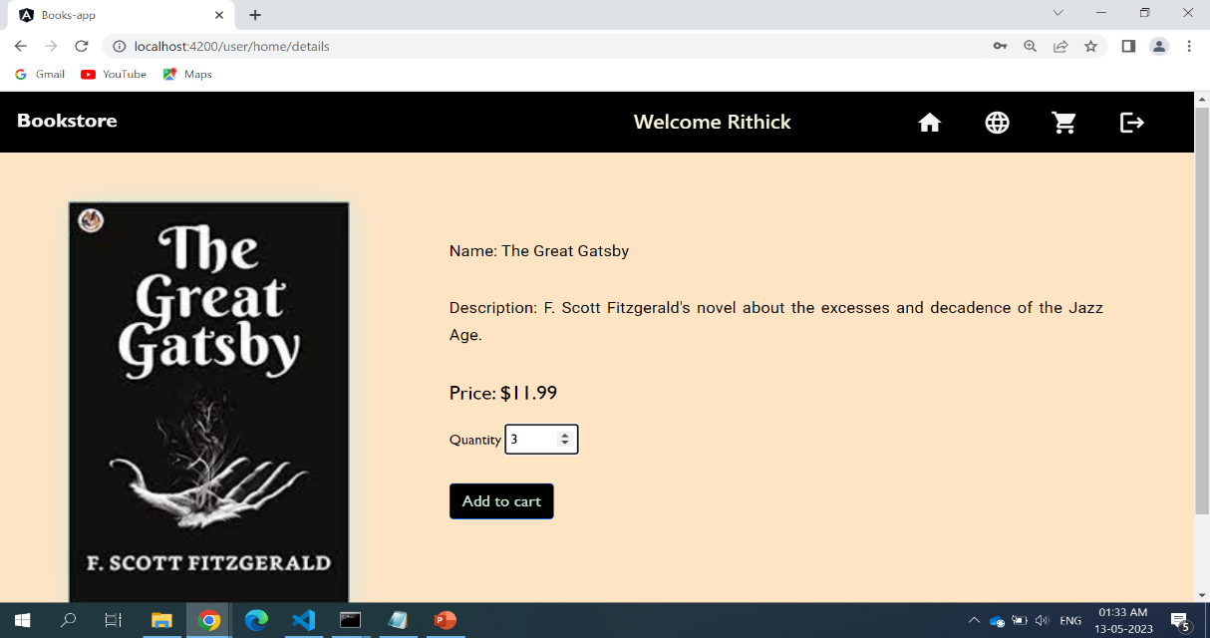
Details page
If you click the products in the home page , it will give the details of the products
With Name,Description,Price,and quantity
Add to cart button is added to this details page

Slide 7
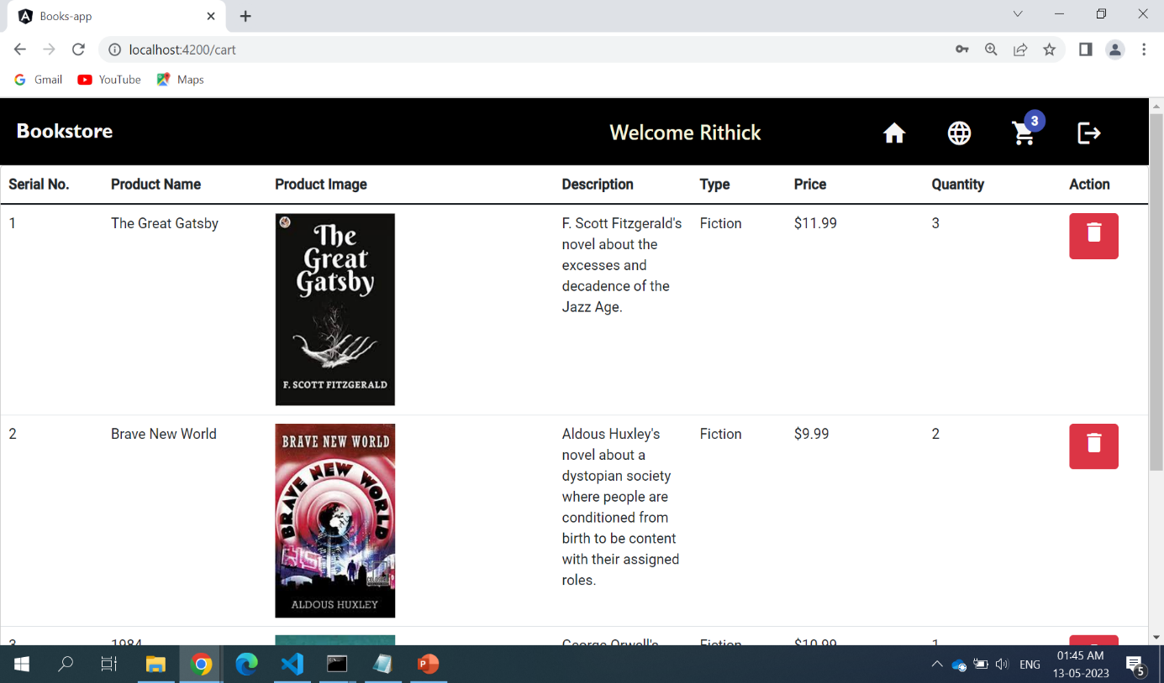
Cart page
By clicking add to cart with quantity , the book will be added to cart
It will be displayed with product name , image , descp,type and price
Action delete button is given to remove the product from the cart

Slide 8
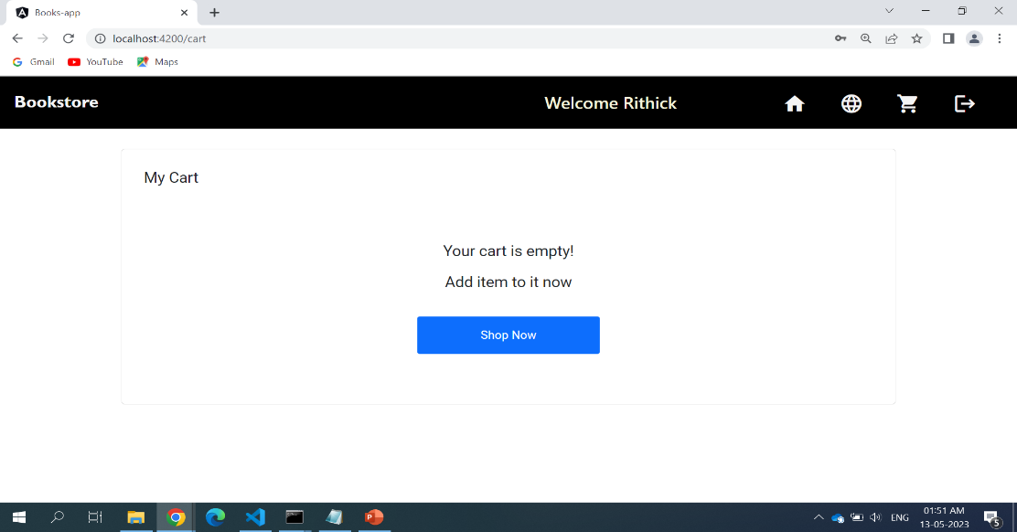
Empty cart
By removing all the products from the cart it will say your cart is empty
By clicking the show now button it will route to home page again

Slide 9
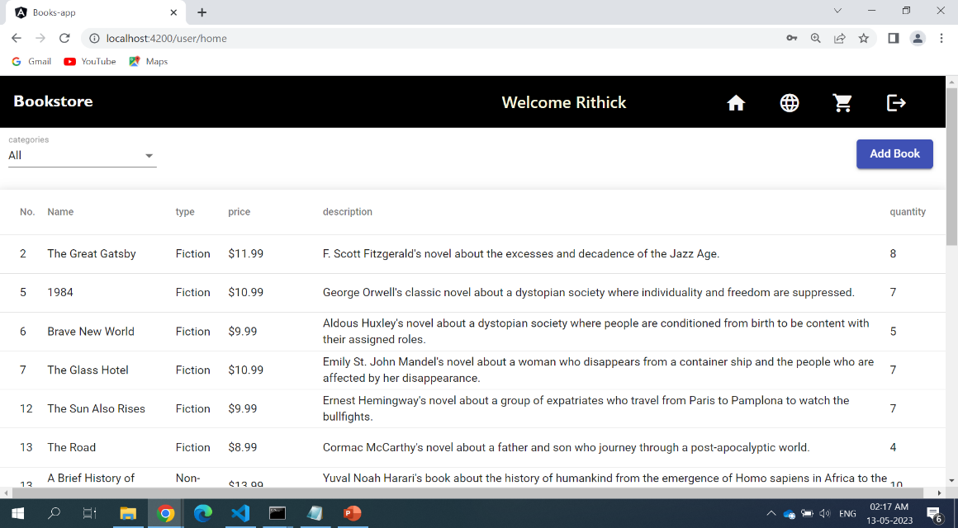
Admin home page
In admin page the product is listed in grid table using angular material
The admin page also displays a addbook button to add books to the products list

Slide 10
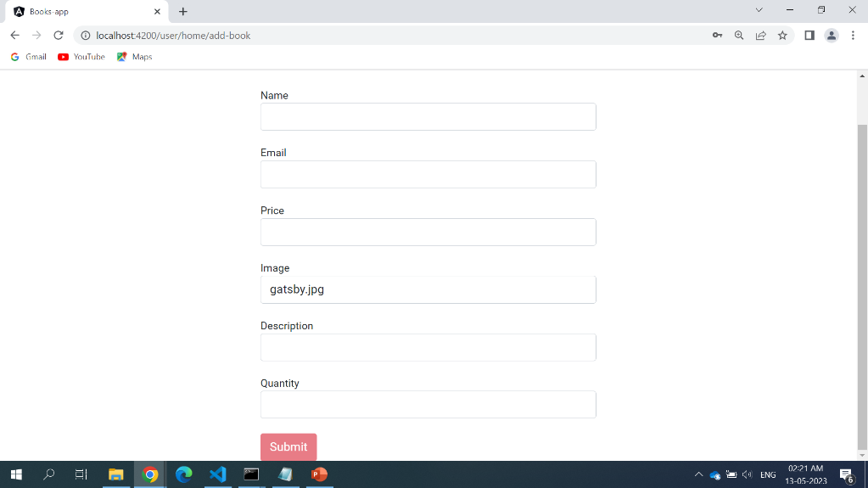
Add book page
By clicking the addbook button, a form will be opened
After submitting the with a new product book details , it will be added to the user .
By doing this a snackbar will be popped up as (Book added successfully)
Admin can add and delete a book

Slide 11
Thank you…

